Slide 1
Likelihood Ratio Tests
And
Model Selection
Notes:
a

Slide 2
Hypothesis Tests to Compare Models (not parameters)
One can use the likelihood ratio test to compare two models when
both are based on the same data
one of the models is “nested” within the other
That is, one model is a special case with a parameter equal to a specific value (usually zero) from the more general model.

Slide 3
Nested Models
The following models are nested:
y = Time + Depth * Region
y = Depth * Region
The following models are not nested:
y = Time + Depth * Region
y = Temp + Depth * Region

Slide 4
Hypothesis Tests for Models
Model A nested within more general model B can be compared as follows:
H₀: Model A fits the data as well as Model B
(with fewer parameters)
H_{A}: Model A does not fit the data as well as Model B
(you need those extra parameters)
Fit models A and B and record:
the negative log-likelihood at the best fit
the number of parameters in models A and B, p_{A} and p_{B}.

Slide 5
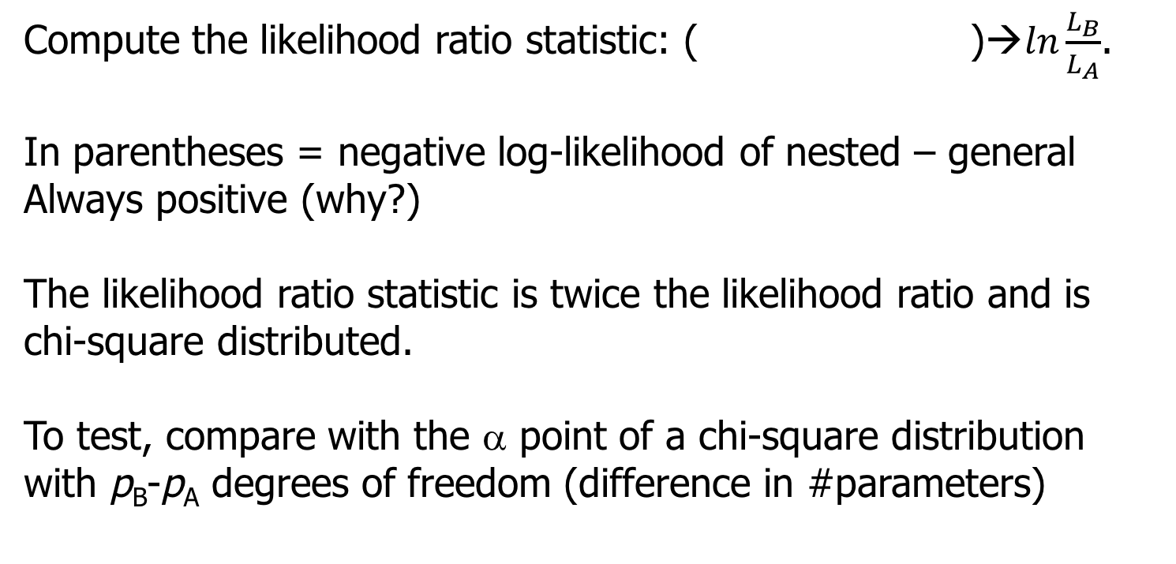
Hypothesis Tests for Models
Compute the likelihood ratio

Slide 6
Example where null is nonzero
You monitor an intersection for cars that run the red light. Based on 50 days of observation, you detect 30 days on which “light running” took place. You repeat the “experiment” after a red light camera is installed and now observe 10 days on which “running” occurred.
How do we know if there is a significant difference in the rate of running red lights after a camera is installed?

Slide 7
Example-I
Let us define P₁ as the probability of running the light before the
camera was installed and P₂ the probability after the camera
The Binomial likelihood function (ignoring the normalizing constant):
Model A: The probability of running the light has not changed
(P₁=P₂; The more specific model; you only need 1 parameter)
Model B: P₁ may differ from P₂.
(The more general model – more parameters)

Slide 8
Example-II
Summary for this example
Model A: 0.4 0.4 67.30
Model B: 0.6 0.2 58.67
The difference between the negative log likelihoods
67.3 - 58.7 = 8.6
Twice this difference is 17.2
Is this significant given the difference in parameters is 1?

Slide 9
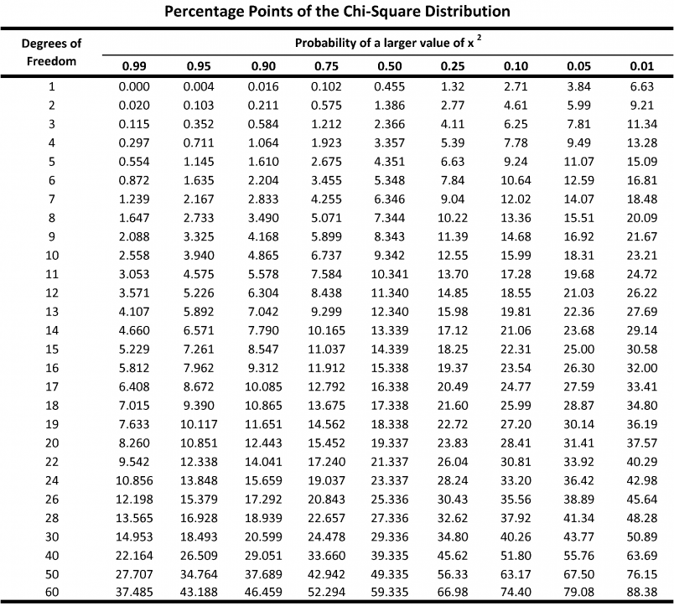
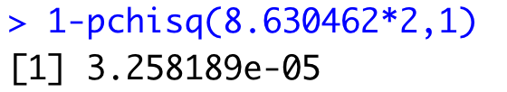
Example-II
The difference between the negative log likelihoods is 8.6 – is
this significant given the difference in parameters is 1?
2*8.6=17.2, compare to chisq distribution with one d.f
REJECT THE NULL
That the one parameter model fits that data. Much better to use two parameters, indicating that the probability of running the red light has changed!

Slide 10
Likelihood ratio test can typically only be applied to nested models
“Information theoretic” approaches (e.g. AIC, BIC) can be used to compare non-nested models.
Models with smaller values of AIC or BIC are “better”, or “have more support” or “are more parsimonious”, but we’ll dig into what this really means for AIC and BIC.

Slide 11
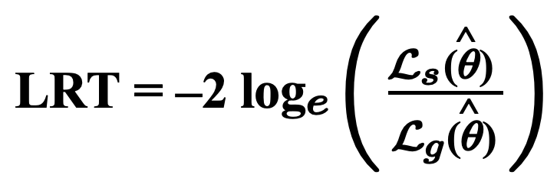
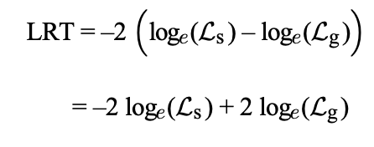
Information Theoretic Criteria for Model Selection (i.e. AIC, BIC, etc.)
The likelihood ratio statistic is twice the log of the likelihood ratio
Compare to chi.sq distribution with degrees of freedom = # parameters
Can also be written as difference in log-likelihoods or deviances

Slide 12
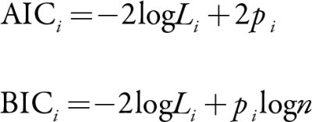
Information Theoretic Criteria for Model Selection
Compare to chi.sq distribution with degrees of freedom = # parameters
Look familiar?
AIC and BIC are meaningless on their own, but models with lower values are more parsimonious (i.e. supported). They balance better fit with more parameters. This is exactly what the likelihood ratio test does.

Slide 13
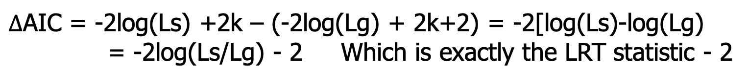
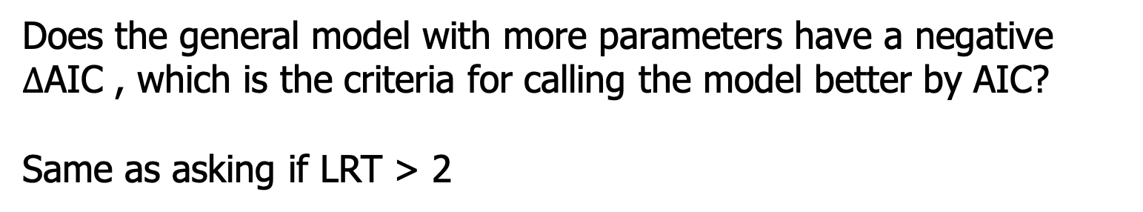
Information Theoretic Criteria for Model Selection
Compare to chi.sq distribution with degrees of freedom = # parameters
Say you compare two models with k parameters and with k+1

Slide 14
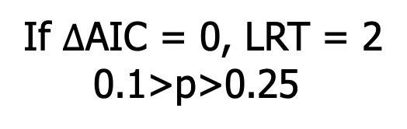
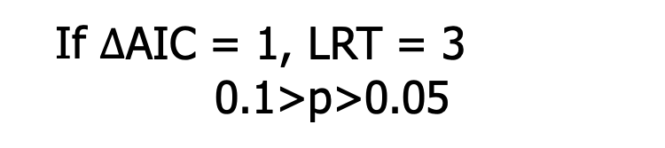
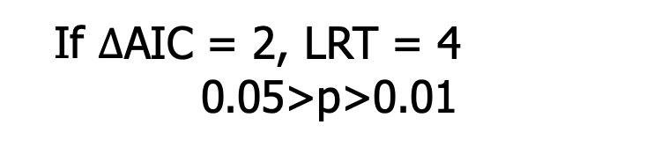
If 1 parameter separate the model. AIC likes bigger models
Convention within>2 AIC units are “considered competitive”, and this is approximately the same as frequentist model selection using LRT

Slide 15
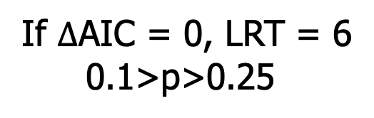
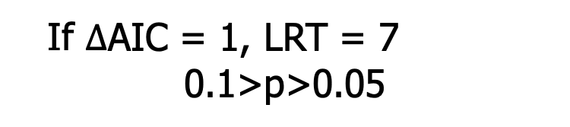
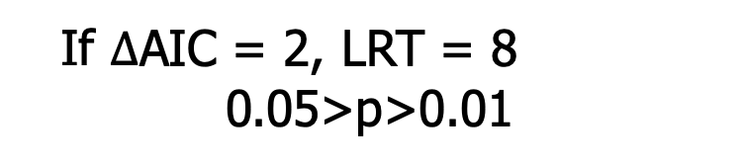
What if 3 parameters separate the model? AIC likes bigger models
(reject the null that the parameters equal 0)
2 deltaAIC still equivalent to p = 0.05

Slide 16
Most common mistake in ecology!
Interpretation of relative AIC is not symmetric
If a more complex model has higher AIC but less than 2 units, it is NOT competitive
Penalty for adding parameter is 2 units and fit improves with complexity, so models with random data as predictor will be within 2 AIC.
The 2 AIC convention is about whether a more complex model with lower AIC is better enough relative to simpler model (in the sense that the parameters are informative)
Notes:
Cue: Taal, show why with a simulation and math

Slide 17
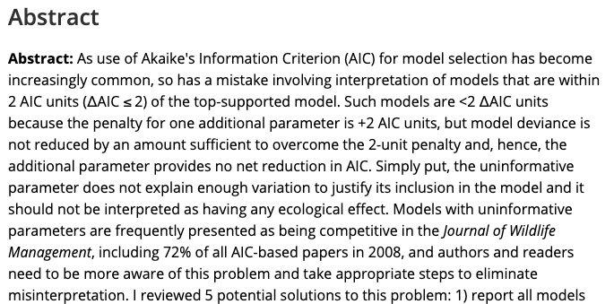
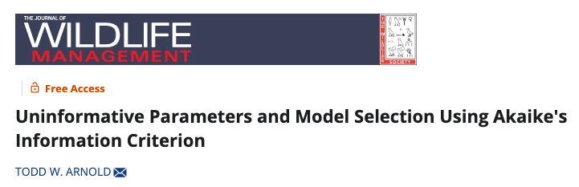
3700 Citations!
72% of all papers incorrectly interpret uninformative parameters!

Slide 19
From statisticians Mark Brewer and Adam Butler

Slide 28
Why does the cult of AIC hate p-values?
P < 0.05 is an arbitrary threshold
But ⍙AIC < 2 is as well
AIC doesn’t suffer from Type I error or problems with autocorrelation
This is just wrong, as we will see by simulation. Making inference by AIC has MUCH MORE Type I error
P-values don’t tell us how important an effect is – i.e. whether the effect is biologically significant. Use effect sizes and confidence intervals instead
AIC doesn’t tell you that either. And I notice big tables full of models with no effect sizes or R², sometimes without even an intercept only model. What if all the models are terrible?
We always need effect sizes for inference. These are the most important part of the science!
But let’s remember how confidence intervals and p-values are related

Slide 29
Confidence intervals and p-values
Estimate and 95% CI. What is p?
Estimate and 99% CI. What is p?
-3 -2 -1 0 1 2 3
Effect sizes and p tell you the same thing as effect sizes and CIs!

Slide 30
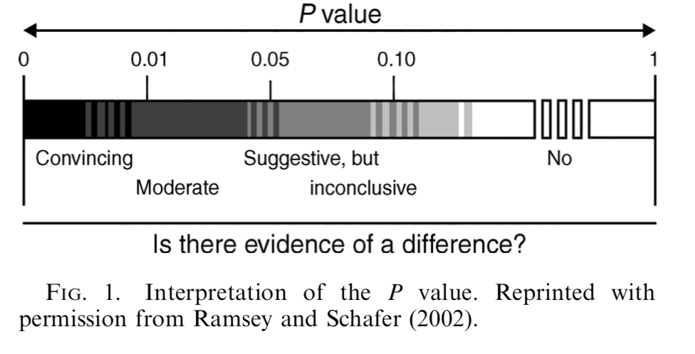
P-values should be interpreted on a continuum. Not a step function at 0.05. AIC should be interpreted in the same way!
deltaAIC=2
deltaAIC=7

Slide 31
So why use AIC?
It is easy to assess non-nested models of highly variable structure.
It is good for selecting models for prediction
Useful when you have lots of potentially correlated predictors
But it is widely used for inference, resulting in more Type I error
Often used incorrectly, resulting in more error (more on this later)

Slide 32
Why did AIC take over wildlife science?
Aggressive marketing of the method by Burnham and Anderson, who were in Fisheries and Wildlife and “wrote the book”
People adopt new statistical methods, then find the holes, and then the pendulum swings back
It feels rigorous because you have to run so many models
People like ranking things

Slide 34
Which is the top model? Which models are competitive?

Slide 35
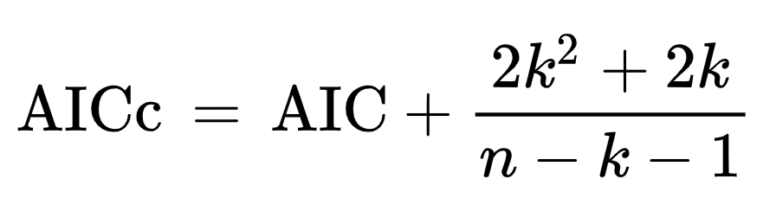
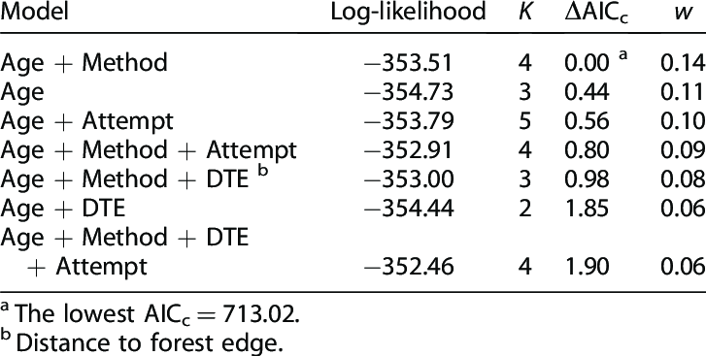
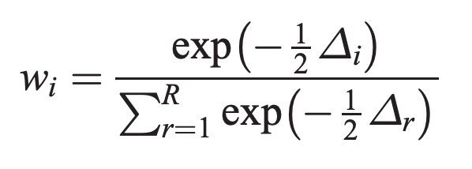
AIC in practice
For small sample sizes, AIC is biased and so people use AICc. AICc is treated as “corrected AIC” and converges to AIC for large n.
Model weights. Each model i of R is weighted based on its deltaAIC.
Variables included with lots of model weight considered important.
Model weight used for averaging across models for prediction
Both deltaAIC and weights depend on model set. Notice, no intercept model here, estimates, or R². All the models could be garbage.
Why would I HATE this table as presentation of results?

Slide 36
Most common mistake in ecology!
Interpretation of relative AIC is not symmetric
If a more complex model has higher AIC but less than 2 units, it is NOT competitive
Penalty for adding parameter is 2 units and fit improves with complexity, so models with random data as predictor will be within 2 AIC.
The 2 AIC convention is about whether a more complex model with lower AIC is better enough relative to simpler model

Slide 37
3700 Citations!
72% of all papers incorrectly interpret uninformative parameters!

Slide 38
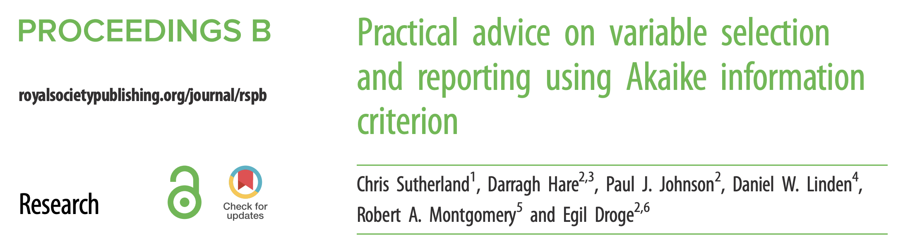
Best recent paper as a resource to stop doing dumb stuff with AIC

Slide 40
Burnham and Anderson did not advocate model dredging (fitting all/many combinations of predictors)
If you look at many models, you will have many Type I errors leading to “overfitting”.
But did ecologists listen to B&A and construct sensible model sets?
Hell no
Do ecologists even think about whether the purpose of modeling is inference or prediction?
Also no
“An investigator with, say, 10 explanatory variables cannot expect to learn much from his data and a multiple linear regression analysis unless there is some substantial supporting science that can be used to help narrow the number of models to consider. In this example, there would be 1,024 models (many more if transformations or interaction terms were allowed), and over-ﬁtting would surely be a serious risk. The analysis, by whatever method, should probably be considered exploratory and the results used to design further data gathering leading to a more conﬁrmatory analysis, based on some a priori considerations” (Burnham and Anderson 2002:85)

Slide 41
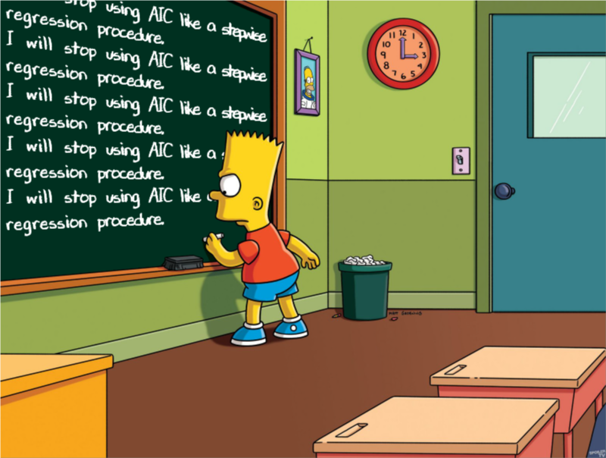

Slide 42
Then what about BIC? Is it just a similar alternative?
The penalty in BIC increases with the sample size
AIC retains more complex models than BIC or p-values
AIC chooses the model that gives the best prediction. It is efficient for prediction.
BIC chooses the “correct” model if it is in the set.

Slide 43
AIC vs BIC
“Theoretically, AIC is optimal in the sense of minimizing the mean square error of predictions, whereas a competing metric, the Bayesian Information Criterion (BIC; Schwarz 1978), is consistent – that is, it will tend to select the ‘true’ model as the sample size increases to infinity.”
AIC is asymptotically equivalent to leave-one-out crossvalidation (prediction), and BIC is most similar to inference (p-values)

Slide 44
Crossvalidation: Split data, train model, compare predictions to actual using test data. Repeat.
k-fold crossvalidation
Leave-one-out (n-fold crossvalidation)
Dataset
Train
Test

Slide 45
Recommended Readings
Aho et al. 2014 “Model selection for ecologists: The worldviews of AIC and BIC”. Ecology
Shmueli 2010 “To explain or to predict”. Statistical Science
Murtaugh 2007 “Simplicity and complexity in ecological data analysis”. Ecology
Arnold 2010 “Uninformative Parameters and Model Selection Using Akaike's Information Criterion” JWM
”Murtaugh 2014 “In defense of P-values”. Ecology
Fieberg and Johnson 2015 “MMI: Multimodel Inference or Models With Management Implications?”. Journal of Wildlife Management
Sutherland et al. 2023 “Practical advice on variable selection and reporting using Akaike information criterion. Proceedings B
Bolker 2024 “Multimodel Approaches Are Not the Best Way to Understand Multifactorial Systems”. Entropy

Slide 46
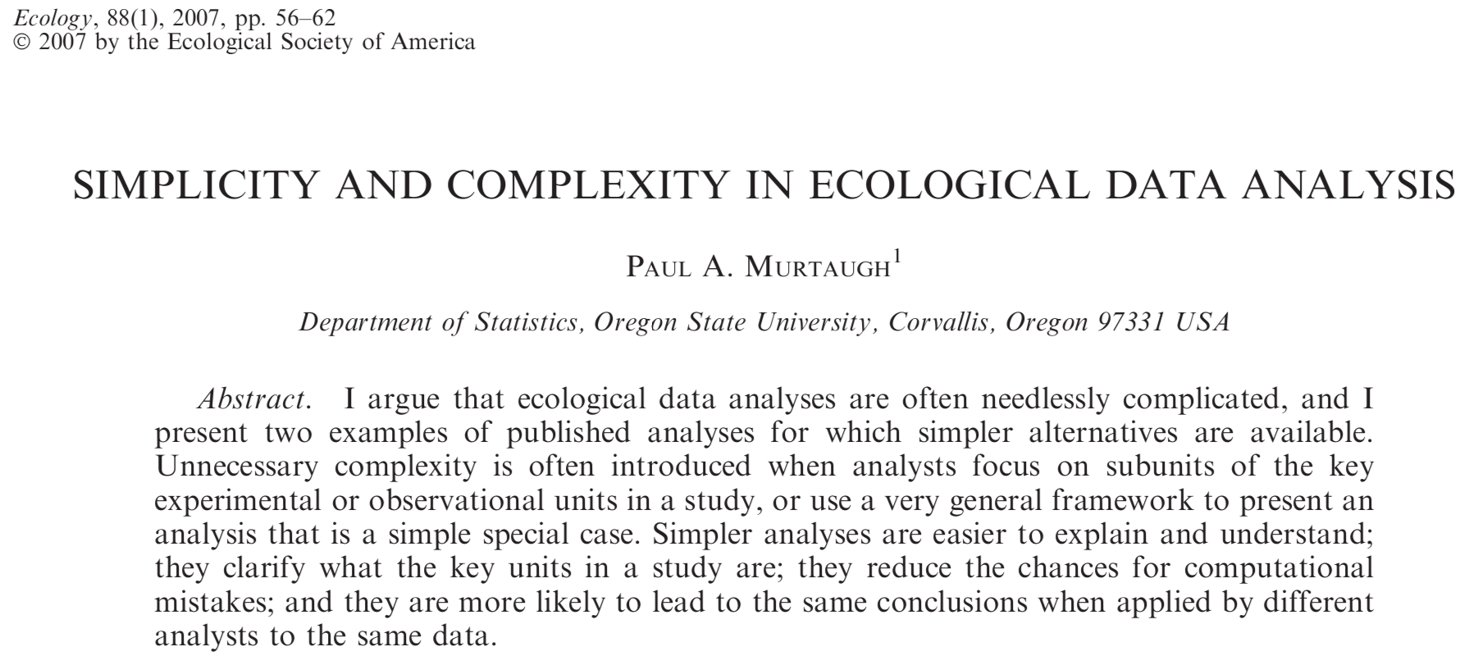
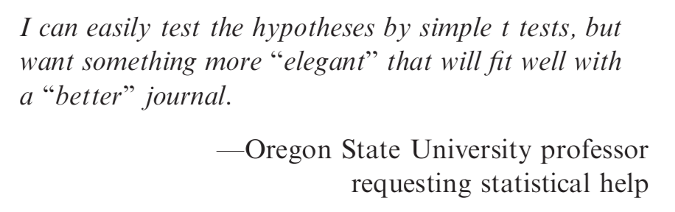

Slide 47
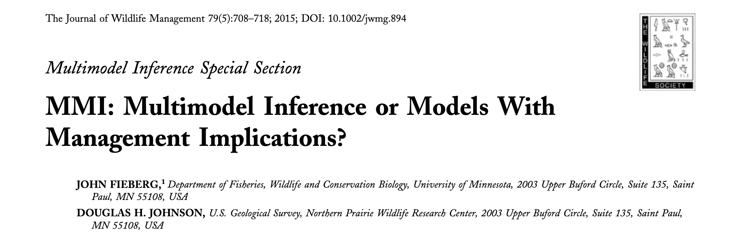
Don’t take my word for it…
One way to avoid some of the problems associated with model selection is to “just say no” to data-driven model selection—in other words, ﬁt a single pre-speciﬁed model, one in which all explanatory variables are chosen prior to looking at their relationship with the response variable, and then use this model for inference (Harrell 2001, Babyak 2004, Whittingham et al. 2006, Guidice et al. 2012).

Slide 48
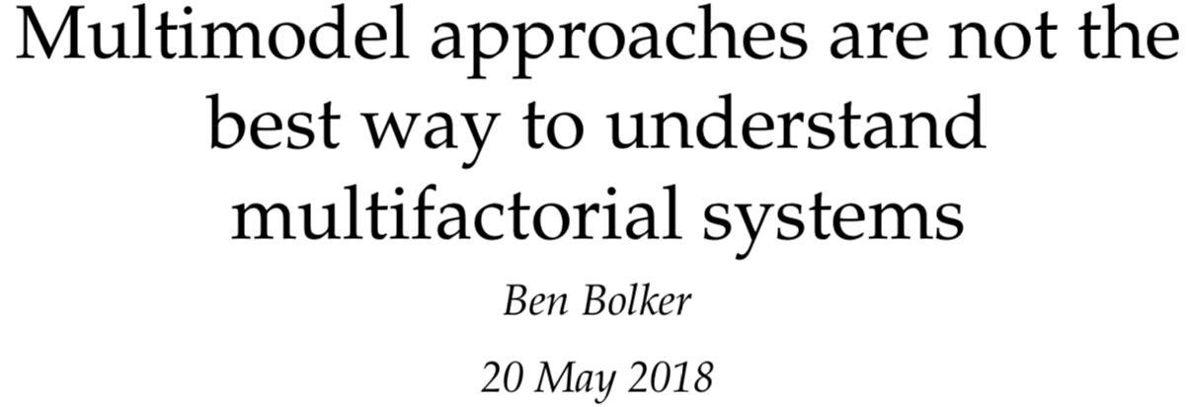
Don’t take my word for it…
“If researchers want to accurately estimate the strength of multiple competing ecological processes along with reliable confidence intervals, their best hope is to use full (maximal) statistical models after making principled, a priori decisions about which predictors to include. “
Left as a preprint for years until Bolker finally submitted it to a journal after we chatted about this problem

Slide 49
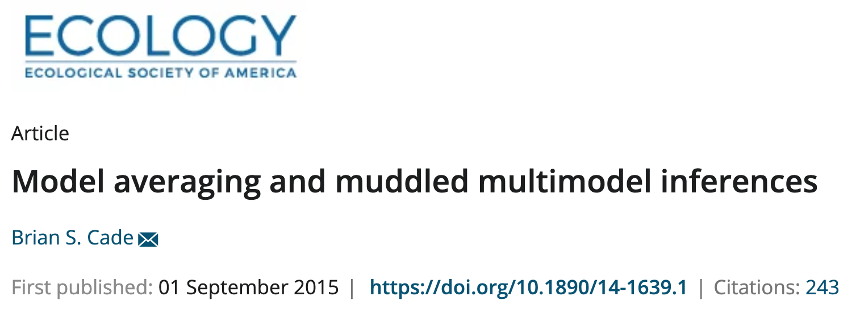
Don’t take my word for it…
The associated sums of AIC model weights recommended to assess relative importance of individual predictors are really a measure of relative importance of models, with little information about contributions by individual predictors compared to other measures of relative importance based on effects size or variance reduction.
The standardized estimates or equivalently the t statistics on unstandardized estimates also can be used to provide more informative measures of relative importance than sums of AIC weights. Finally, I illustrate how seriously compromised statistical interpretations and predictions can be for all three of these flawed practices by critiquing their use in a recent species distribution modeling technique developed for predicting Greater Sage‐Grouse (Centrocercus urophasianus) distribution in Colorado, USA. These model averaging issues are common in other ecological literature and ought to be discontinued if we are to make effective scientific contributions to ecological knowledge and conservation of natural resources.

Slide 51
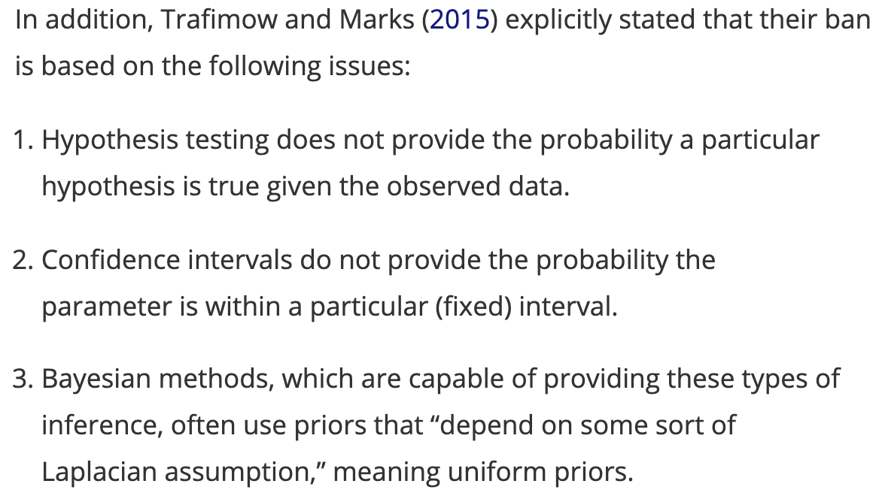

Slide 52
Are any statistical procedures required?
No, because the state of the art remains uncertain. However, BASP will require strong descriptive statistics, including effect sizes. We also encourage the presentation of frequency or distributional data when this is feasible. Finally, we encourage the use of larger sample sizes than is typical in much psychology research, because as the sample size increases, descriptive statistics become increasingly stable and sampling error is less of a problem.
banning the NHSTP will have the effect of increasing the quality of submitted manuscripts by liberating authors from the stultified structure of NHSTP thinking thereby eliminating an important obstacle to creative thinking

Slide 53
Hmm…let’s think, will banning the use of p-values 1. Reduce type I errors and help solve the replication crisis in Psychology? 2. Allow absolute garbage conclusions to be published that would otherwise not have passed “significance testing”
Large-scale efforts (e.g., the Open Science Collaboration’s Reproducibility Project in 2015) showed that only about 35–40% of published effects could be replicated with similar effect sizes.

Slide 54
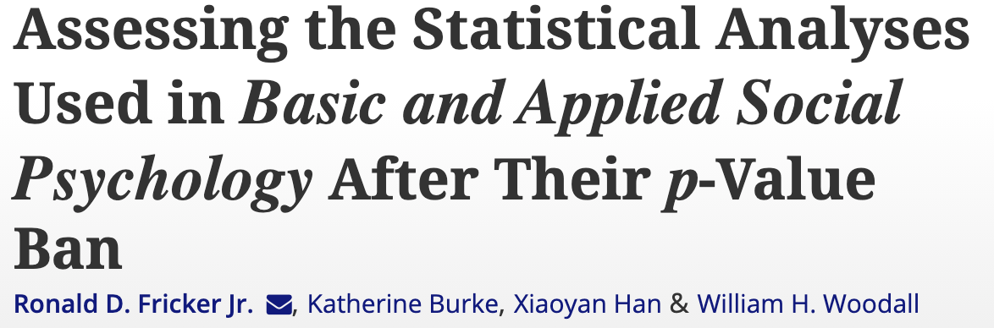
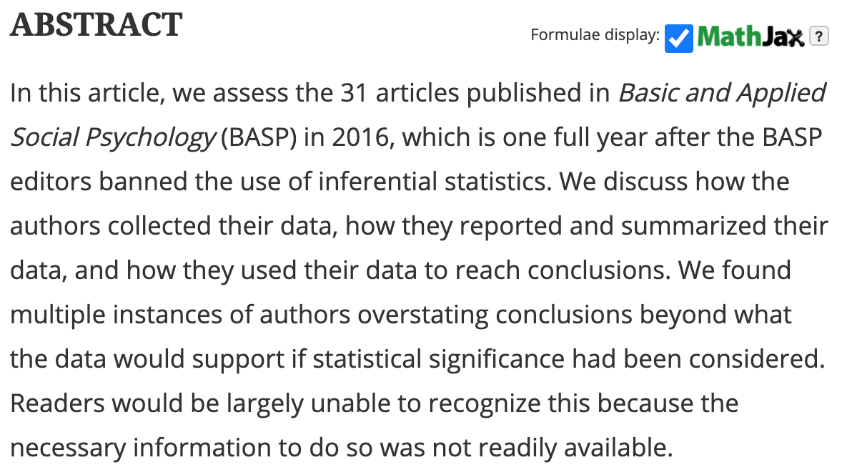

Slide 55
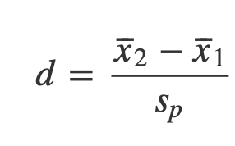
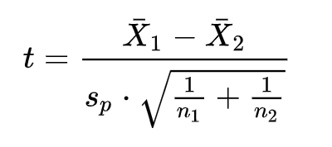
Further buffoonery
Journal: you should use Cohen’s d to compare two samples
0.2≤d<0.5 indicates there is a “small” practical effect
0.5≤d<0.8 indicates a “medium” practical effect
d≥0.8 indicates a “large” practical effect
Does Cohen’s d look familiar?

Slide 56
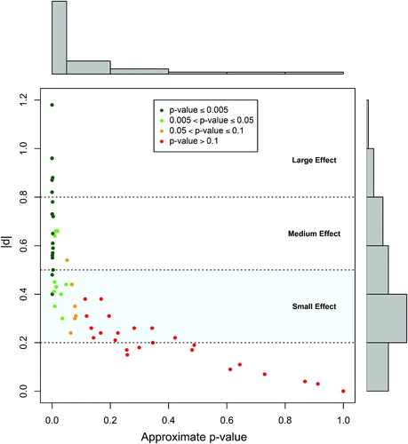
Further buffoonery
d values larger than Cohen’s minimum medium effect size were statistically significant and all below Cohen’s small effect size limit were not
For d values that correspond to small effect sizes (45.3% of the d values), there is no way to decide whether a particular d value is consistent with random fluctuations in the data under the assumption of equal population means without some measure of statistical significance
How do you think the media will report on these results? Cautious and measured?

Slide 57
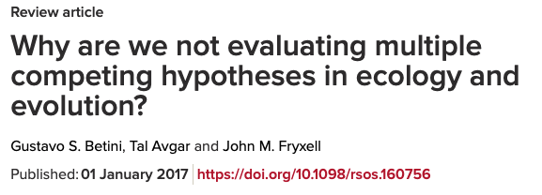
The chief benefit of AIC/BIC
Stresses the importance of evaluating multiple competing hypotheses when applied properly to actual competing hypothesis
“While often used as a tool for statistical inference, a set of regression models containing partially overlapping sets of explanatory variables does not necessarily represent a valid evaluation of multiple hypotheses unless each statistical model represents a unique research hypothesis [31]. In other words, model competition, based on AIC and BIC, is not a stepwise regression procedure.”

Slide 58
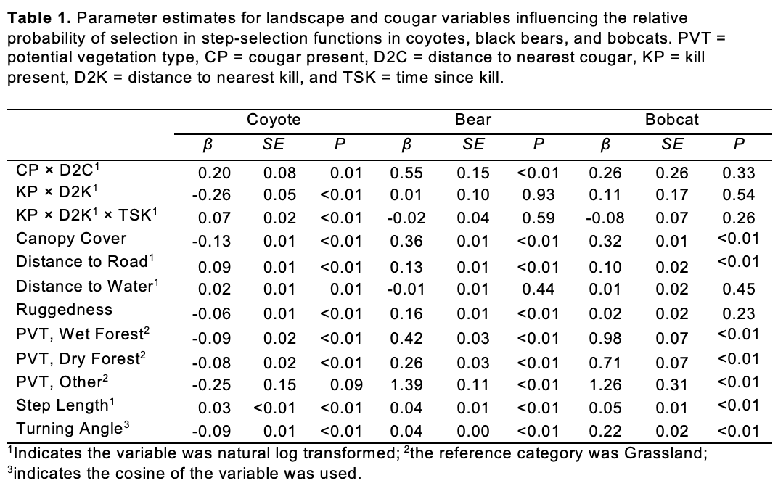
Compare habitat only models for resource selection vs. models that include interactions with cougars.
Species | ΔAIC
 | Habitat Only | Habitat + Cougar
Bobcat | 0 | 2.69
Bear | 10.36 | 0
Coyote | 24.0 | 0

Slide 59
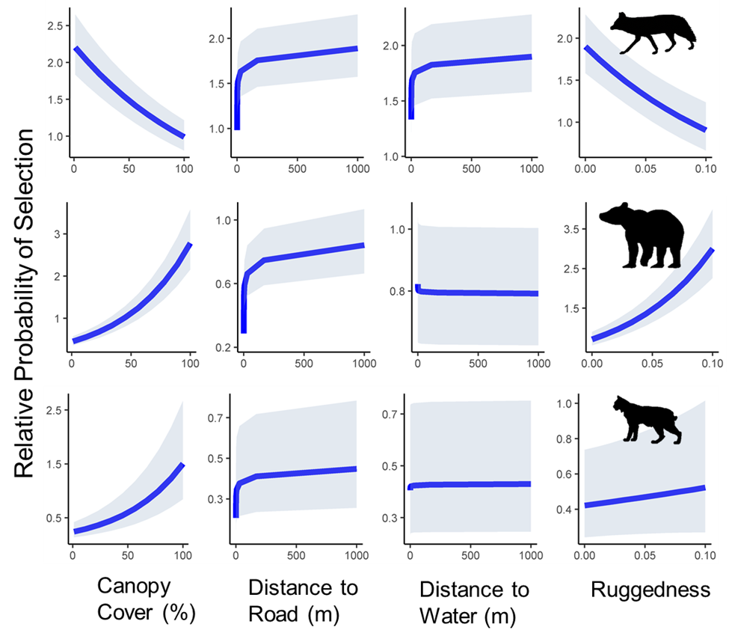
How SHOULD we be making inference
Interpret point estimates algebraically and geometrically with uncertainty
Don’t ask “if” there is an effect. Ask how much a variable affects an outcome
Quantify our uncertainty around this

